Slide 1
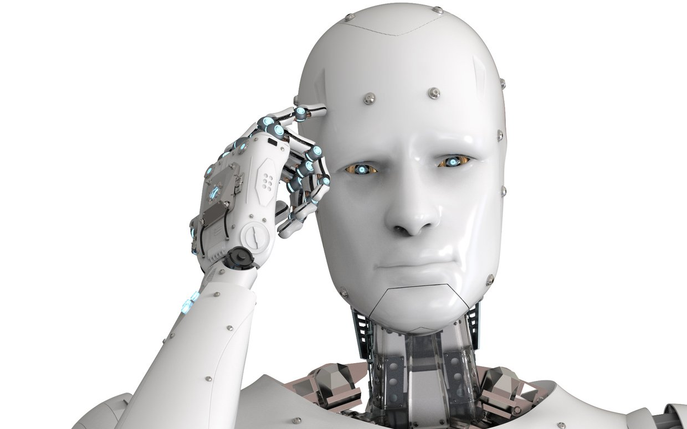
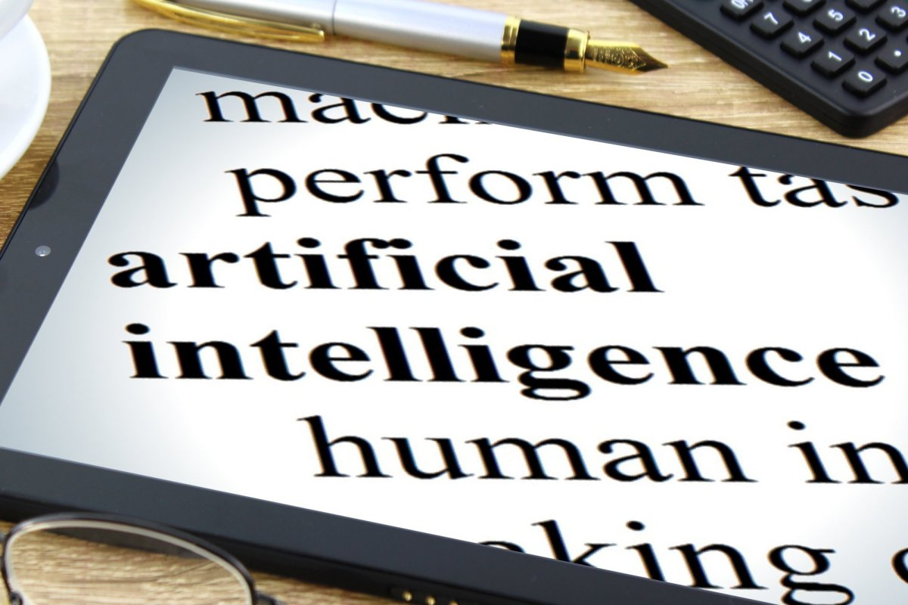
SHOULD WE BE CONCERNED ABOUT AI TAKING OVER HUMAN JUDGEMENT?
Adnan Yawar
MD Saadman Hossain
Chaojun(Wade) Xu
Surabhi Modak
Wing(Whitney) Yeung

Slide 2
What is AI?
Artificial intelligence (AI) refers to the simulation of human intelligence in machines that are programmed to think like humans and mimic their actions.
AI techniques, known collectively as “machine learning“. These allow a machine to learn a task without being programmed with explicit instructions

Slide 3
Who is the stakeholders?
-Organization, Health
-Engineering and Product Development Teams
-Human Resources
-Legal
-Union
-Government
-IT Professional
-Insurance companies
-Automotive industry
-Everyone

Slide 4
Positive Aspects
Insurance companies - Insurance companies are using AI and machine learning to automate certain parts of the claims handling process and improve customer service. Blockchain is being used to detect fraud and prevent risk. AI has only scratched the surface of the insurance industry. There are dozens of processes that could be greatly improved using AI, and over time, more insurance providers will implement the technology across their business. Some of the applications that can benefit most from AI include pricing, claims handling and fraud detection.
AI creates more opportunities for judgment – AI increases the value of human judgement and creative thinking. AI has zero judgment, only humans have judgment. AI is not displacing humans, but rather empowering humans to focus more on the judgment role, as opposed to the combined prediction-judgement routine of decision making. If the art of prediction becomes faster, better, and cheaper, that will give way to more decisions to make. Giving human knowledge workers the opportunity to ditch the mundane, soul-sucking tasks like data entry to focus on more strategic, meaningful, and rewarding work.

Slide 5
Positive Aspects
Automotive company owner - Top car manufacturers have embraced robotics and leaders in the automotive supply chain are embracing artificial intelligence (AI) to take on tasks such as quality control. Artificial intelligence is not only changing the cars on the road, but the factories that build them. robots are used to automate factory tasks that are tedious, dirty, or even dangerous for human workers. Robots work with humans on the supply chain, tending machines, handling materials, performing tests, and packing finished products.
Machinery lifespan determination (Example) - DataRPM’s machine learning technology gets to know a machine’s normal patterns of behavior and can predict future issues and breakdowns which saves time and money. DataRPM utilizes machine sensor data to optimize capabilities. The technology reduces unplanned downtime, increases asset life and operational efficiency, and enhances equipment effectiveness effort to cut costs and increase efficiency.
Self-driving example - nuTonomy is creating autonomous technology for completely driverless vehicles. nuTonomoy’s technology, nuCore allows for flexible and human-like vehicle handling (without the error). The software enables vehicles to navigate even the most complex traffic situations.

Slide 6
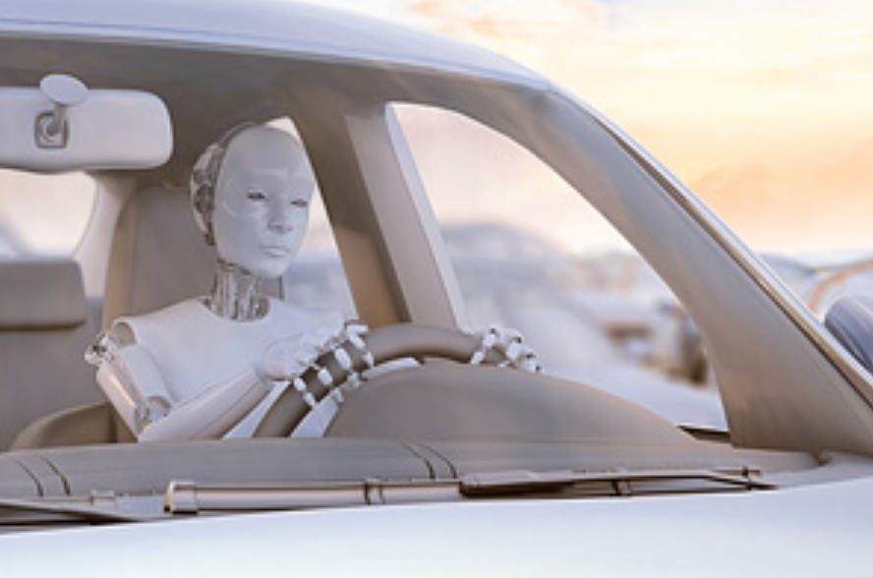
Concerns & Consequences
Terrorist ：new forms of AI-based terrorism may emerge from the expansion of drones and the introduction of robot swarms to long-range attacks or the spread of diseases through nanorobots. Our law enforcement and defense organizations will need to adapt to these potential threats.
Citizen: they don’t have control what the Government use AI which impact their life. For example, AI is an instrument being used to centralize state power over citizens in China.
Drivers - Automation makes the usability of self-driving cars at high-risk
For example, in 2018, Uber self-driving car hit a pedestrian who later died. After the investigation, prosecutors have decided that the company is not criminally liable for the pedestrian’s death. This is because the safety driver was distracted with her cell phone, and police reports label the accident as “completely avoidable.”

Slide 7
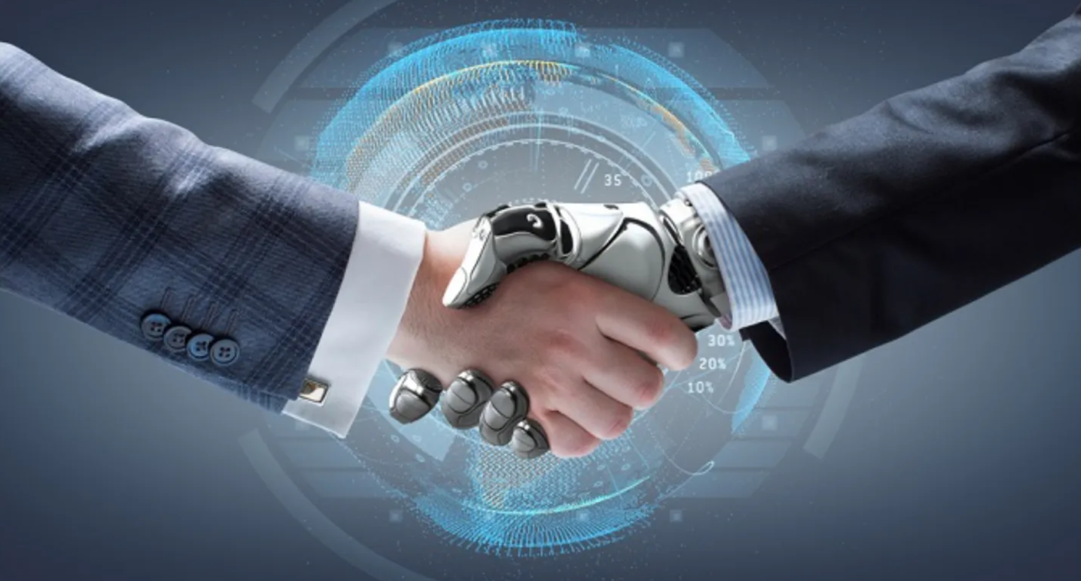
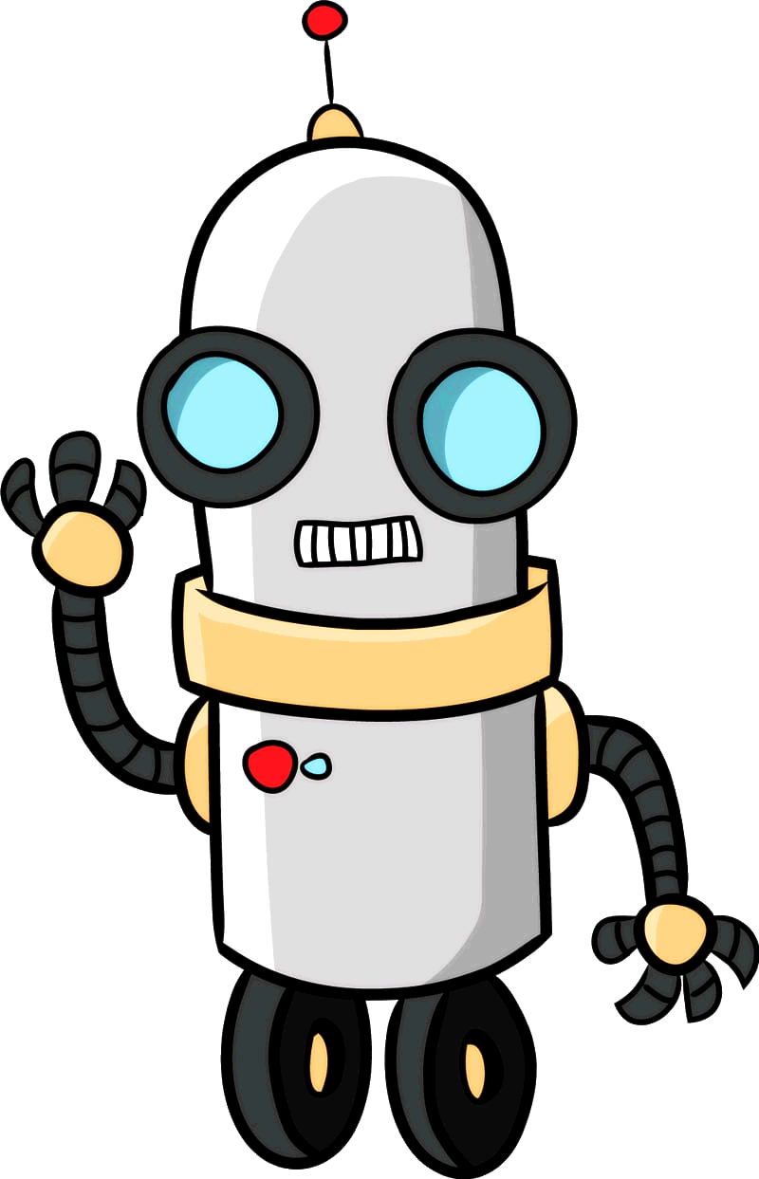
Concerned about AI taking over human judgement?
YES
NO
They are easy to manipulate and unregulated.
The threat is overblown but the potential is real.
AI has zero judgment, only humans have judgment?
AI is going to win against human intelligence?

Slide 8
Conclusion & Team’s Statement
AI can learn and develop biases; AI is data and instruction driven. Therefore, we concerns how human feed training data to the machine which would impact AI judgment.
YES, we concern
Machine learning and artificial intelligence are tools. They can be used in a right or a wrong way, like everything else. It is the way that they are used that should concerns us, not the methods themselves. Human greed and human intelligence scare us far more than artificial intelligence.

